Slide 1
BALAJI TEMPLE MATRIMONIAL SERVICES REGISTERED ASPIRANTS BRIDES

Slide 2
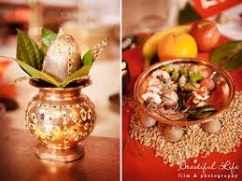
2021
01G21
Hindu Brahmin – Tamil & Telugu background, British Citizen
Dorn : October 1997, Height: 5’3.5’’ Mother Tongue : Telugu (knows Tamil)
Qualification: B.Sc. Maths & Actuarial Science, presently working as Graduate Actuarial Trainee.
Also undertaking exams & training to eventually qualify as a Fellow of the Institute of Actuaries (FIA).
Hobbies: Keeping-fit, Sports, Cooking, Listening-Music, Travel, Reading, Public-speaking, Entrepreneurship.
Prefers a professional qualified in any of : Actuary / CFA / ACA / ACCA /Data Science / IT Software / Engineering.
Looking for a Tamil (or) Telugu, Brahmin Vegetarian, life-partner, who is caring, family-oriented, committed, and willing to be supportive of my career interests and hobbies.
02G21
Hindu Muthurajah, British Citizen
D.O.B.: 06/02/1986 Height: 5feet 2’’
Qualification: ACMA (CIMA) and MSc
Currently working as Chartered Accountant (Head of Finance)
Hobbies: Youtube, Podcasts, Gardening, Yoga, Meditation, Music and Cooking.
Looking for Male aged 36-39 settled in UK. Must be Indian or Colombotamil working in a senior position like businessman, banker, dentist and likewise. Education slightly less than bride is ok. Background and chart match is key. Non smoker, non drinker and non vegetarian. Must be living in UK.

Slide 3
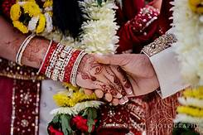
03G21
Hindu Sri-Vaishnavas, Indian Citizen
D.O.B.: 01/03/1996 Height: 5feet 4’’
Qualification: MCA (Computer Applications)
Currently Student
Hobbies: Cooking & Reading.
Looking for an unmarried bridegroom from Sri Vaishnava or Brahmin community/sub caste in well placed and remuneration with background of good character, good family with age below 30 years.
04G21
Hindu Vishwakarma, Indian Citizen
D.O.B.: 21/10/1996 Height: 5feet 7’’
Qualification: Bachelor of Engineering
Currently Student
Hobbies: Classical dance (Bharatnatyam), Yoga.
Looking for Suitable Groom with clean habits, family oriented person.

Slide 4
2020
01G20
No longer available
02G20
Hindu Punjabi, British Citizen
D.O.B.: 9/12/1986 Height: 5’4’’
Qualification: B Com (India), MBA (UK)
Currently working as a Head of Product Development in Limited Company based in London
Hobbies: Reading, Travelling, Music, Cooking, Yoga
Looking for a UK resident, preferably a vegetarian and non-smoker, well settled and educated, Punjabi or Intercast.

Slide 5
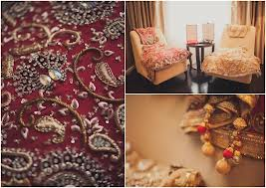
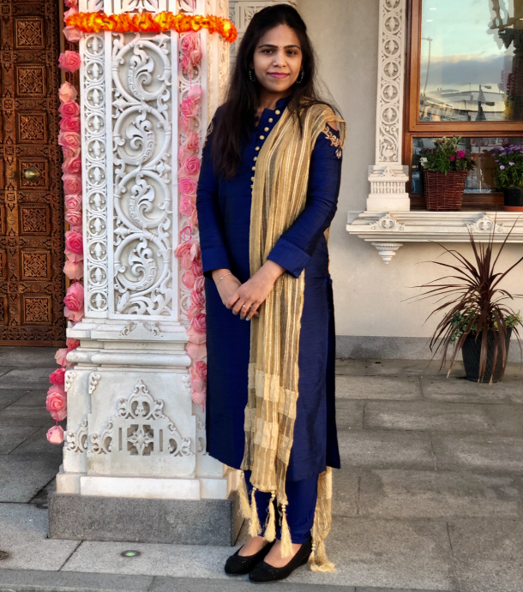
03G20
Hindu, British Citizen
D.O.B.: Nov 1983 Height: 5’3’’
Qualification: MRCGP
Currently working as a General Practitioner
Hobbies: Sports, Music, Films, Reading, travelling
Looking for a Doctor/ Dentist.
04G20
Hindu Balija, Divorced
D.O.B.: 5th August 1987
Qualification: Masters in Information Technology
Currently working as a Customer Service Assistant
Looking for a person from a decent family and settled in UK.
05G20
Hindu Brahmin, Indian Citizen with Tier 2 Visas
D.O.B.: 20th Jul 1990 Height: 5feet3’’
Mother Tongue: Kannada
Qualification: MBBS
Currently working as a FY2 in Darlington Memorial Hospital
Hobbies: Reading, travelling, listening to music
Looking for a Kannada speaking groom preferably medical profession from Brahmin community who lives/ works in UK

Slide 6
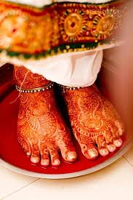
06G20
Hindu Brahmin, Indian Citizen based in UK on Work Permit
D.O.B.: 6th May 1994 Height: 5feet 5’’
Qualification: MBBS – Internal Medicine Training
Currently working as a Doctor – Internal Medicine Trainee – Year 1
Hobbies: Listening to music, watching movies, yoga, singing
Looking for a humble, honest and caring life partner. Preferably an vegetarian
07G20
Telugu Arya Vyasa, British Citizen
D.O.B.: October 1995 Height: 4feet 9’’
Qualification: BA – Honors (Politics & Sociology)
Currently working as a Payroll Accountant
Hobbies: Badminton/ Gym, reading, music, watching TV/ films
Looking for a suitable match within the UK and preferably in the same community, vegetarian. Should ideally be settled and have UK citizenship.
08G20
Hindu Brahmin, Europe Citizenship
D.O.B.: 22/1/1992 Height: 5feet 2’’
Qualification: MBChB, MRCP, BMedSci
Currently working as an Oncologist
Hobbies: Yoga, hiking, baking, singing, reading
Looking for an educated Brahmin, ambitious, kind, dharmic, good family values, vegetarian, non-drinker, non-smoker

Slide 7
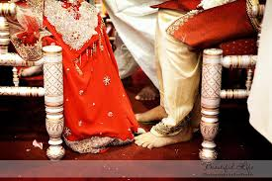
09G20
Hindu Tamil, British Citizen
D.O.B.: 23/9/1986 Height: 5feet 5’’
Qualification: MRCGP/ Fellowship in MSK
Currently working as a GP
Hobbies: Home decorating, painting, playing tennis, travelling
Looking for a Doctor settled in UK
10G20
Hindu Malayalam, British Citizen
D.O.B.: 23/2/1996 Height: 5feet 5’’
Qualification: Bachelors of Optometry - Hons
Currently working as an Optometrist
Hobbies: Bharatanatyam, Art, Movies
Looking for an understanding, spiritually inclined, family oriented and supportive partner ideally with South Indian Origins
11G20
Hindu Tamil Brahmin, Indian Citizen based in Germany
D.O.B.: 13/9/1990 Height: 5feet 4’’
Qualification: PhD in Physics
Currently working as a Researcher
Hobbies: Reading, movies, drawing, hiking, Canoeing
Looking for a Brahmin, vegetarian, non-smoker, unmarried 30-35 years old well settled, education Masters and beyond.

Slide 8
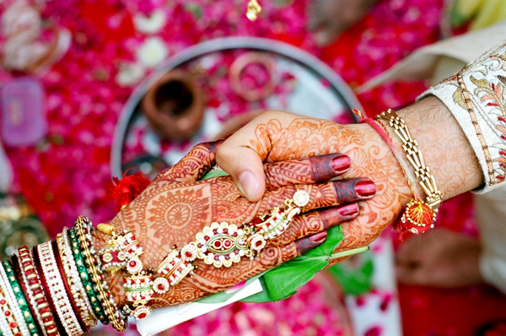
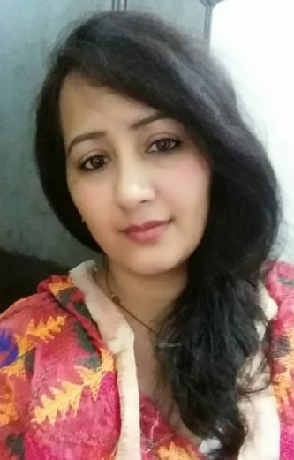
12G20
Hindu Punjabi, British Citizen
D.O.B.: 6/6/1996 Height: 5feet 4’’
Qualification: B Sc. - Mental Health Nursing
Currently working as a Project Co-ordinator - NHS
Hobbies: Reading, Music, Calligraphy, Photography
13G20
Hindu Punjabi, British Citizen
D.O.B.: 28/8/1989 Height: 5feet 4’’
Qualification: Post Graduate - Legal
Currently working as a Project Co-ordinator – NHSRegulatory Analyst
Hobbies: Football, Tennis, Cinema, Music, Gym, Swimming, Yoga, Eating Out
Looking for Liked minded individual, good family values, similar interests, good work – life balance
14G20
Hindu Punjabi, Based in India
D.O.B.: 4/2/1983 Height: 5feet
Qualification: BA - Media
Currently working as a Sub-Editor for a Newspaper
Hobbies: Cooking, watching movies, socialising with family & friends
Looking for a family oriented person who is caring and kind-hearted

Slide 9
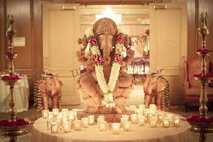
15G20
Hindu Brahmin, Indian Citizen based in UK on ICT Tier 2 visas
D.O.B.: 5/3/1992 Height: 5feet 4’’
Qualification: BCA – Information Technologies
Currently working as a Software Engineer
Hobbies: Music & Drawing
Looking for some working in UK, friendly and supportive and who can guide my family as an elder son. I believe in God and expect the same from my better half.
16G20
Hindu Kamma/ Kshatriya, Indian Citizen based in UK on Tier 2 General visas
D.O.B.: 30/11/1989 Height: 5feet
Qualification: M Sc. – Artificial Intelligence
Currently working as a Data Scientist at an Oil and Gas firm
Hobbies: Drawing, cycling, listening to music
Looking for a professionally well-placed and compatible partner
17G20
Hindu Reddy, Indian Citizen based in UK on Tier 2 Work Permit
D.O.B.: 2nd May 1991 Height: 5feet2’’
Qualification: MBBS, MRCGP
Currently working as a GP Trainee first year
Hobbies: Painting, dancing, cinemas
Looking for a good family and someone with family settled in the UK, preferably doctor and Telugu, but open to others

Slide 10
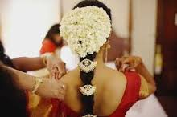
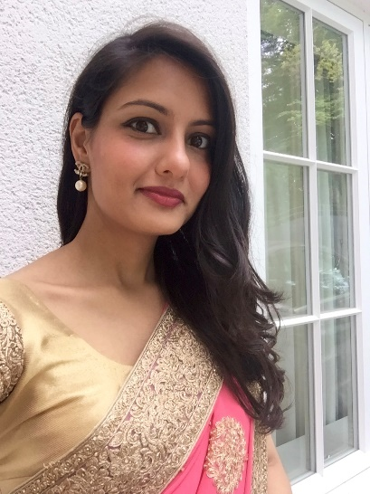
18G20
Hindu Malayalam, British Citizen
D.O.B.: 27th June 1991 Height: 5feet1’’
Qualification: MBChB, Nephrology
Currently working a Medical Registrar ST3 Rotation
Hobbies: Reading, baking, travelling
Looking for Doctor partner
19G20
Hindu Mudaliar, British Citizen
D.O.B.: 29th April 1978 Height: 5feet3’’
Qualification: MBA – Business, Marketing & Chemistry
Currently working in Marketing business
Hobbies: Sports, reading, keep fit classes, cooking, travelling and cinema
Looking for an adventurous, kind soul mate. Non-smoker, social drinker and educated (degree), non-vegetarian
20G20
Hindu Kshatria, British Citizen
D.O.B.: 26th May 1984 Height: 5feet2’’
Qualification: MBBS, MCGP, MS Management
Currently working as a General Practitioner – Healthcare Investor
Hobbies: Reading, hiking, socialising, meeting family, travelling and real estate
Looking for a smart, kind, fun, supportive man who is looking to build a future together

Slide 11
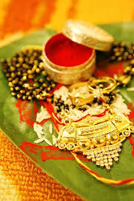
21G20
Hindu Kannada, British Citizen
D.O.B.: 22nd December 1995 Height: 5feet3’’
Qualification: Master’s in Engineering – Bio Medical
Currently working as a Research Analyst
Hobbies: Dancing, painting and interior decorating
Looking for a well educated professional Hindu, preferably vegetarian, UK Citizen

Slide 12
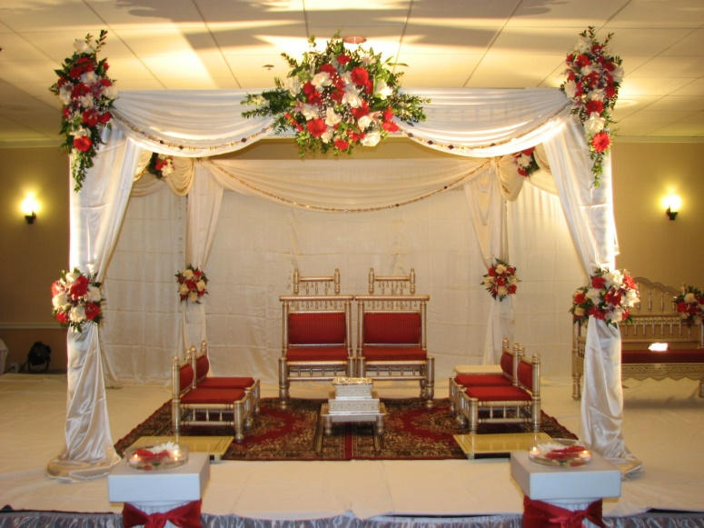
2019
01G19
Kannada Hindu Brahmin, Indian Citizen based in UK on Visit Visa
D.O.B.: 09/05/1994 Height: 5’3’’
Mother Tongue: Kannada
Qualified in MBBS – Passed PLAB 2 and having license to practise in UK
Hobbies: Travelling, Reading, Cooking, Hanging Out with friends
Looking for preferably a doctor from Brahmin Community in UK. Age difference not more than 4 years, should be outgoing, accommodative and fun loving.
02G19
Hindu Punjabi Khatri, British Citizen
D.O.B.: 22/01/1983 Height: 5’3’’
Mother Tongue: Punjabi
Qualified Accountant, Specialised in Banking
Hobbies: Keep fit, Reading, Cooking, Travelling
Looking for an educated boy of good standing
03G19
Konkani Hindu, British Citizen
D.O.B.: 10/03/1986 Height: 5’4’’
Qualified MBCHB, MRCGP
Currently working as a General Practitioner

Slide 13
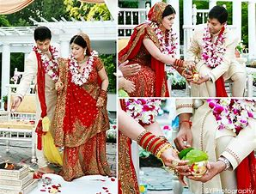
04G19
Hindu Punjabi
D.O.B.: 5/11/1972 Height: 5’1’’
Qualifications: LLB
Currently working in NHS as a health advisor
Hobbies: Healthy eating, cinema, restaurants, watching documentaries
Looking for a Hindu boy, non-smoker/ drinker
05G19
Kannada Hindu, Divorced, Based in India
D.O.B.: 27/02/1981 Height: 5’4’’
Qualifications: M Com
Currently working in a private company
Hobbies: Art & Craft
Looking for an understanding partner
06G19
Tamil Hindu, Malaysian Citizen
D.O.B.: 25/8/1990 Height: 5’5’’
Qualifications: B Sc. – Accounting and Finance
Currently working as an Accounts Manager
Hobbies: Travelling & Swimming
Looking for a Tamil Groom

Slide 14
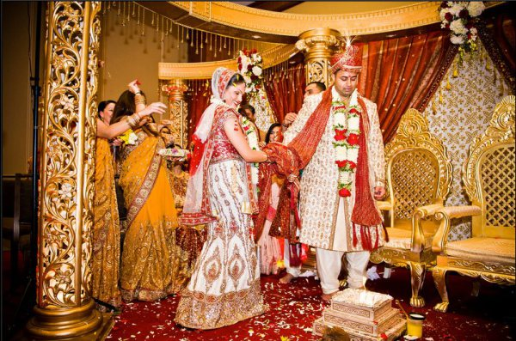
07G19
Hindu Punjabi, British Citizen
D.O.B.: 10/05/1989
Qualifications: B Sc, MBBS (ST3 Anaesthesia)
Currently working at ST3 – Doctor in NHS
Hobbies: Sports (Tennis, Yoga, Running), Guitar, Reading
Looking for an open minded, adventurous, Hindi Speaking(Preferably), professional
08G19
Hindu Telugu Brahmin, Indian Citizen permanently based in UK
D.O.B.: 04/08/1988 Height:5feet 7’’
Qualifications: MBCHB (UK) Specialised in FRCR
Currently working as Speciality Training Program
Hobbies: Half Marathon, baking cakes
Looking for a doctor doing specialisation (in core training program or have completed)
09G19
Hindu Tamil, Permanent UK Citizen with Indian Citizenship
D.O.B.: 12/10/1991 Height:5feet 5’’
Qualifications: BDS (India)
Currently working as Trainee dental Nurse, M Sc. Public health student (Dentistry)
Hobbies: Tamil movies, listening to music, home decorations, foodie
Looking for an educated, easy going, jovila, down to earth person settled in the UK, who is interested in a life partnership with me rather than my family circumstances.

Slide 15
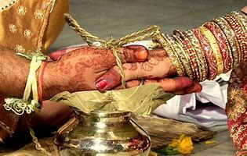
10G19
Hindu Tamil, British Citizen
D.O.B.: 13/03/1995 Height:4feet 8’’
Qualifications: BA – Accounts & Finance
Currently working as an Accountant Assistant
Hobbies: Dancing (Bharatanatyam), Learning Guitar
Looking for an Indian Hindu Boy, educated and working
11G19
Telugu, British Citizen
D.O.B.: 07/10/1981 Height:5feet 8’’
Qualifications: MBBS, MRCP (Chest Physician)
Currently working as a Hospital Consultant
Hobbies: Reading, photography, sight seeing, music, cooking
Looking for a professional gentleman, height 5feet 8’’ or more, working and settled in UK
12G19
Hindu Punjabi, British Citizen
D.O.B.: 12/06/1993 Height:5feet 2’’
Qualifications: M Sc. In Nutrition & Diabetics
Currently working as a Nutritionist
Hobbies: Travelling, reading, cooking and being active
Looking for a well educated, unmarried, Hindu Khatri/ Brahmin (preferably Punjabi)

Slide 16
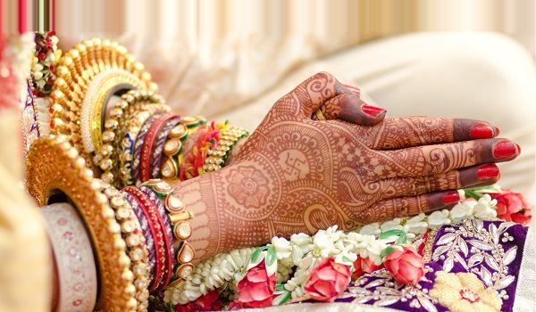
13G19
Hindu Punjabi, British Citizen
D.O.B.: 23/08/1989, Feet: 5feet 2’’
Qualifications: B Sc. Children’s learning & development
Currently working as a Nutritionist
Hobbies: Travelling, reading, cooking and being active
Looking for a well educated, unmarried, Hindu Khatri/ Brahmin (preferably Punjabi)
14G19
Tulu, British & Indian (Dual) Citizenship
D.O.B.: 08/04/1994
Qualifications: B Sc. Honours
Currently working as a Nurse
Hobbies: Gym, going away on holidays with family
Looking for a family oriented, well cultured person with good job and qualifications
15G19
Tamil Hindu, British Citizen
D.O.B.: 24/11/1993
Qualifications: MBBS
Currently working as a Doctor
Looking for a professional groom preferably a doctor

Slide 17
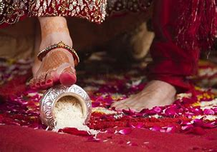
16G19
Hindu- Balija Naidu, Indian Citizen
D.O.B.: 06/12/1981, Height: 5feet 2’’
Qualifications: MBBS – General Surgery
Currently working as a hospital doctor
Hobbies: Sports and games
17G19
Hindu Punjabi, Brahmin
D.O.B.: 11/12/1991 Height: 5feet 6’’
Qualifications: MSc. Economics, B Sc. In Honours
Currently working as an Economist
Hobbies: Shopping, cinemas, travelling, listening to music and dancing, eating out
Looking for someone who is settled in the UK and belongs to a Hindu Brahmin/ Khatri (preferably Punjabi or Hindi speaking) family. Looking ideally for an educated professional (aged 27-31) and with good height (perferably 5feet 9’’ or more). Would like somebody with good personality who is kind, family oriented, broadminded and down to earth.
18G19
Hindu Punjabi, Divorced, Indian Citizen on family visitor visas
D.O.B.: 5/8/1979 Height: 5feet 5’’
Qualifications: Diploma – Electronic & Communications
Currently working as a Product Training Manager in Delhi
Hobbies: Cooking, singing
Looking for working professional, divorcee (with children will also be considered)

Slide 18
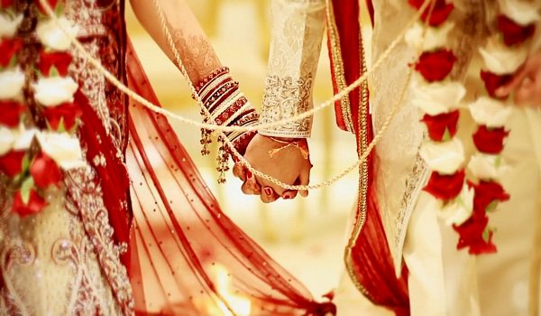
19G19
Hindu Tamil, British Citizen
D.O.B.: 17/06/1996, Height: 5feet 7.5’’
Qualifications: B Sc. Business Management
20G19
Hindu Telugu, Indian Citizen on Tier 2 visa, Divorced
D.O.B.: 03/04/1973, height: 5feet 6’’
Qualifications: MBBS, ND (OBG), MRCOG – Obstetrics & Gynaecologist
Currently working as a Registrar in NHS Hospital
Hobbies: Yoga, Fitness, Walking, Movies & Music (Telugu & Hindu)
Looking for a suitable groom of age 45-50 (preferably South Indian)
21G19
Hindu Tamil Kongu Vellalar Gounder, British Citizen
D.O.B.: 19/11/1993, height: 5feet 3’’
Qualifications: MBBS Final Year Student
Hobbies: Reading, listening to music, travelling, Skiing
Looking for Tamil groom, a doctor, preferably raised and educated in the UK with close-knit family, values and modern outlook

Slide 19
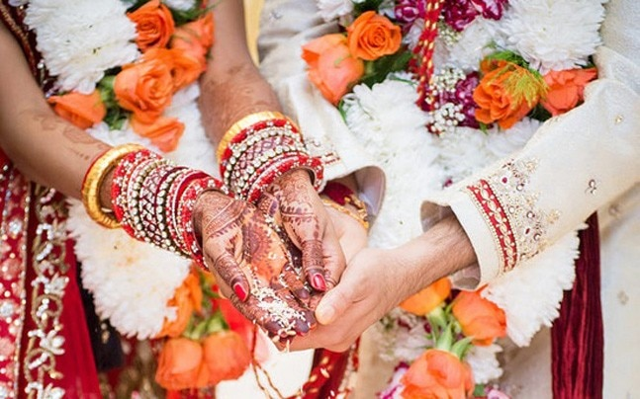
22G19
Hindu Tamil, Indian Citizen on indefinate leave to remain
D.O.B.: 27/03/1984, height: 4feet 9’’
Qualifications: MBA, Masters in Finance
Hobbies: Painting, Hiking, Running, Playing violin
Looking for a well-employed boy with good educational qualifications and good family background
23G19
Hindu Kannada Brahmin, British Citizen
D.O.B.: 19/9/1994, height: 5feet 5’’
Qualifications: B Sc. (Honors)
Hobbies: Music, reading, travelling
Looking for reliable, good looking, U.K based boy
24G19
Hindu Punjabi Khatri, British Citizen
D.O.B.: 25/5/1981, height: 5feet 6’’
Qualifications: LLB Law Degree
Currently working as a Solicitor
Hobbies: Travelling, dining out, spend time with family, read
Looking for a caring, kind hearted, someone who makes me smile, family type, mixture of modern and traditional values

Slide 20
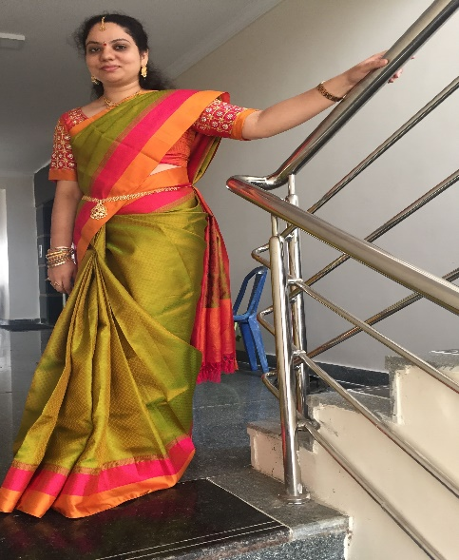
25G19
Telugu Hindu Kamma
DOB: 1/1/1983, Height: 5feet 5’’, Indian Citizen, Divorced
Qualifications: BPT, MIAP - Physiotherapy
Currently working as a Physiotherapist
Looking for a responsible, caring, and kind hearted person who is more human than man
26G19
Tamil Hindu, Indian citizen based in UK
DOB: 6/7/1994, Height: 5feet 7’’
Qualifications: B Sc. Computer Science
Currently working Aviation Industry – Passenger service
Hobbies: Reading, cooking, travelling, movies and crafts
Looking for a well educated, unmarried, non smoker/ drinker Hindu groom (aged 25-29) family oriented and down to earth person settled in UK
27G19
Telugu Hindu Brahmin DOB: 9/6/1993, height: 5feet 3’’ Qualifications: MD Currently working as a NHS Doctor Looking for a handsome Brahmin practicing medical doctor groom preferably born and raised in UK, US, Canada or Australia

Slide 21
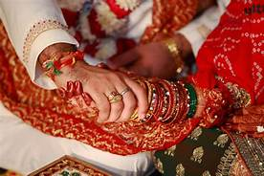
28G19
Telugu, Indian Citizen currently based in USA happy to move to UK DOB: 14/02/1988, Height: 5feet 2’’ Qualifications: B tech, MS (Chemical) Currently working as a System Analyst Hobbies: Art, Handicraft, cooking, painting Looking for an educated and working Hindu Boy (preferably South Indian)
29G19
Tamil Naidu, Indian Citizen currently based UK, ready to relocate to UK DOB: 11/11/1993, Height: 5feet 4’’ Qualifications: BDS - FGDS Currently working as a Dentist, Cosmetologist, Preparing for exams to work in UK Hobbies: Listening to music Looking for a groom from same caste based in UK.
30G19
Hindu, Brahmin Iyer, British Citizen DOB: 17/01/1995, Height: 5feet 6’’ Qualifications: MBChB Currently working as a FY1 - Doctor Hobbies: Piano, Tennis, Travelling Looking for a Brahmin boy between the ages of 25-31, preferably a doctor, born and grown up in the UK.

Slide 22
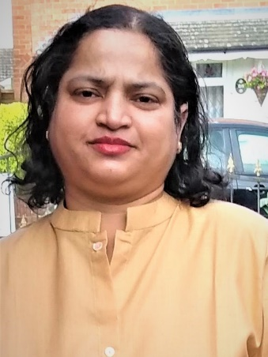
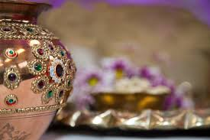
31G19
Hindu, Konkani, British Citizen DOB: 06/05/1978, Height: 5feet 2’’ Qualifications: B.Sc.(Hons) Biomedical Sciences Currently self employed Hobbies: Cooking, Gardening Looking for a well educated and learned, simple, kind, rational in his dealings, compassionate from traditional high class family
32G19
Hindu, Punjabi, British Citizen DOB: 7/07/1992, Height: 5feet 3’’ Qualifications: B.Sc, M.Sc Currently working as a Medical Statistician
33G19
Hindu, Punjabi, British Citizen DOB: 7/07/1992, Height: 5feet 7’’ Qualifications: B.Sc, MBBS Currently working as a NHS Doctor

Slide 23
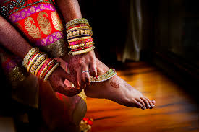
34G19
Hindu Telugu, Indian Citizen based in UK
D.O.B.: 22/07/1992, Height: 5feet
Qualification: Completed MBBS in India, Passed PLAB
Looking for a Brahmin doctor groom settled or willing to settle in the UK.
35G19
Hindu Punjabi, Kenyan/ British Citizen
D.O.B.: 22/5/1981, Height: 5feet 4’’
Qualification: Pharmacist
Hobbies: Reading, Travelling, swimming
Looking for a well educated, well settled, good natured
36G19
Hindu, Indian Citizen based in India, Divorced
D.O.B.: 25/8/1984, Height: 5feet 2’’
Qualification: PhD / Doctorate – Economics & International relations
Hobbies: Reading, Travelling, music, movies
Looking for a someone preferably working in UK, someone who is compatible, shares a bond of trust, mutual understanding & care, besides being a husband, a companion and a friend for life.

Slide 24
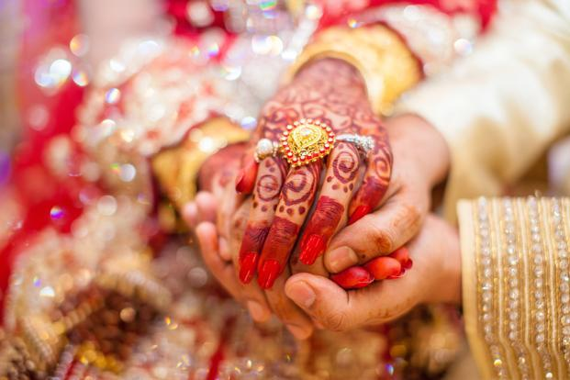
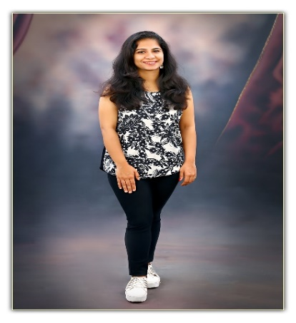
37G19
Unmarried Hindu with Indian citizenship currently in visitor visa living in Essex D.O.B: 06/11/1975. Height: 5ft3’’
Mother Tongue: Hindi. Caste No Bar
Masters Degree in Psychology
Present Occupation: Advertising
Hobbies: Reading, Travelling
Looking for 44-48yrs
38G19
Hindu Sindhi, Kenyan/ Indian Citizen living in Bangalore
D.O.B.: 28/9/1994, Height: 5 feet
Qualification: Bachelors in Electronics Engineering
Present Occupation: Developer at Accenture
Hobbies: Cooking, Yoga, Walking, Dancing
Looking for a handsome, fun loving, open minded boy between 25-28years
39G19
Hindu Kapu, Mother tongue: Telugu, British Citizen
D.O.B.: 14/4/1994, Height: 5 feet 5”
Qualification: Masters in Research - Oncology
Present Occupation: Research Assistant (University of Manchester)
Hobbies: Sports, movies, playing piano, photography, painting, cooking, baking, art & design, reading and travelling
Looking for a partner aged 26-32 years, height 5.8 to 6 feet, Hindu Telugu, never married, professional, non vegetarian, UK citizen or Permanent Visa status

Slide 25
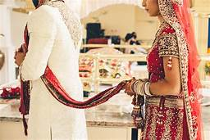
2018
01G18
Unmarried Hindu Punjabi
D.O.B.: 17/08/1993 Height: 5’5’’
Mother Tongue: Punjabi, speaks English
Qualified in BSc in Economics.
B Sc. In Economics, working as a Procurement Manager within Government
Hobbies: Spending time with friends and family, cooking, gym and travelling
An educated partner with a good personality
02G18
Hindu Brahmin, Bharadwaja Gotram
D.O.B.: 14/4/1984
Mother tongue: Telugu, British
Qualifications: M.D., MRCP
Currently working in NHS – rotating medical registrar
Hobbies: Travelling, watching plays
Looking for: Only Brahmins, South Indian preferred, any good profession
03G18
Hindu Kammavar Naidu, Ullatla
D.O.B.: 18/04/1994
Mother tongue: Telugu
Qualifications: Masters – Sustainability and Management
Currently working as a Sustainability Consultant
Hobbies: Reading, travelling, walking
Looking for: Looking for a Hindu professional between 24-28 settled in the UK with the similar family background

Slide 26
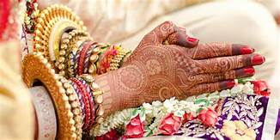
04G18
Hindu Brahmin Vadama, Garga Gothram
D.O.B.: 05/09/1991
Mother Tongue: Tamil
Qualification: M Sc – Dental Science, Just completed post graduation
Hobbies: Drawing, painting, music
Looking for a Tamil Brahmin, UK or EU Citizen, qualified PHD/ MBA/ Doctor and good family background
05G18
Punjabi, Caste: Bali, based in India
D.O.B.: 06/05/1984, Height: 5feet 4’’
Qualification: BA graduate, LLB
Hobbies: Travelling, watching movies, music, socialising, long walks, gym
Looking for someone well settled, good family with similar interest, age between 33-38 years
06G18
No longer available

Slide 27
07G18
Hindu Naidu Kamma
D.O.B.: 07/05/1992, Height: 5feet 6’’
Qualification: B Sc. (Optometry), British Citizen
Hobbies: playing veena, reading, cooking, travelling, music
Looking for a professional groom settled in the UK
08G18
Hindu Patel
D.O.B.: 24/11/1979 Height: 5 feet 4’’
Qualification: BA (Hons) Specialised in Business Management
Hobbies: Travelling, Music, Outdoors, Spirituality, Spending time with family and friends
Looking for someone kind, caring, family oriented, educated with similar interest
09G18
Hindu, British Citizen
D.O.B.: 08/10/1989, Height: 5 feet 3’’
Qualification: MBBS, 1st year Radiology Trainee (ST1)
Hobbies: reading fiction and philosophy, film, hiking, travelling, music and fitness
Looking for a professional, intelligent, open minded, ambitious, caring and kind aspirant

Slide 28
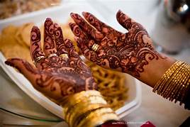
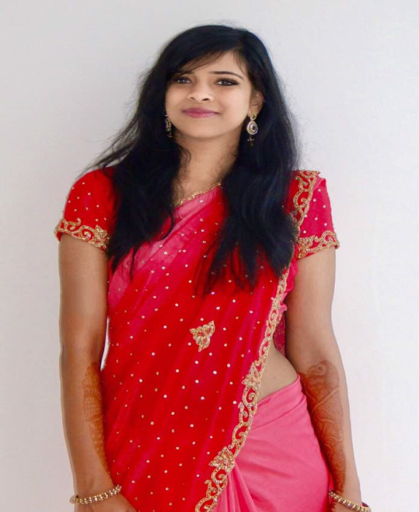
10G18
Telugu, Arya Vysya, UK Citizen
DOB: 10/07/1992, Height: 5feet 4’’
Qualifications: MBBS, B Sc.
Currently working as a Junior Doctor – F2
Hobbies: Bharatanatyam, Carnatic vocal, Western Violin
Looking for an professional based in UK, Hindu preferably Telugu, UK citizen only
11G18
Hindu Brahmin, UK Citizen
DOB: 6/7/1988, Height: 5feet 2’’
Qualifications: MBBS, MRCP
Currently working as a Registrar
Hobbies: Cooking, reading, painting, gardening, watching movies and visiting places
Looking for a Brahmin boy preferably non medicine, working in UK
12G18
Tamil Hindu Brahmin, Indian Citizen based in UK
DOB: 19/11/1992, Height: 5feet 9’’
Qualifications: MBBS, MD, MRCP in General Medicine
Student
Hobbies: Drawing, Listening to music, playing basket ball and watching sports channels
Looking for good looking, tall, professional post graduate groom settled or willing to settle in UK

Slide 29
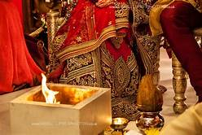
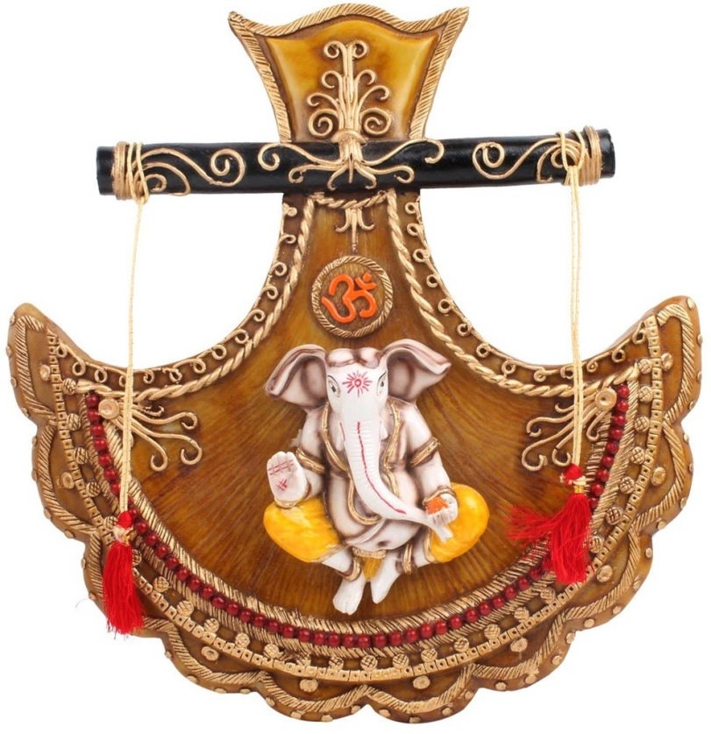
13G18
Hindu Naidu, Baliga
DOB: 21/06/1983, Height: 5feet 6’’
Qualifications: B Sc. (Hon) Biology, Member of Royal Society of Biology (AMRSB)
Working as a Lab Assistant
Hobbies: Reading, listening to music, playing sports, dancing
Looking for a suitable partner willing to settle in UK and with good family values and with similar interests
14G18
Hindi, British citizen
DOB: 07/04/1988, Height: 5feet 6’’
Qualifications: MBBS (London), MRCGP Training, B Sc.(Birmingham)
Currently in 3rd Year GP training
Hobbies: Charity, piano, arts & craft including painting
Looking for a Hindu professional, British Citizen, aged between 30-35 broad minded with traditional family values and good caring personality
15G18
Hindi, Brahmin (Iyer), British
DOB: 12/4/1993, Height: 5feet 3’’
Qualifications: BMBS, B Sc. In Honours
Currently working as F1 Junior Doctor in London
Hobbies: Running, plays veena, reading, listening to various music
Looking for groom based in London, vegetarian, unmarried, professionally qualified from Brahmin, working and settled in the UK.

Slide 30
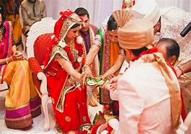
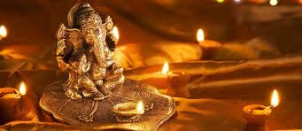
16G18
Hindi, Brahmin (Vaidiki)
DOB: 4/7/1988, Height: 5feet 4’’
Qualifications: B Com (Computers)
Currently working as SR QA Assurance Engineer
Hobbies: Reading, listening to music, painting
Looking for a groom who is well settled and educated
17G18
Telugu Brahmin, Based in India
DOB: 19/05/1991, Height: 5feet 5’’
Qualifications: Bachelor in Engineering
Currently working for Deloitte as a Sr. Consultant
Hobbies: Book reading, singing, watching movies
Looking for a match with a professional background
18G18
Tamil Brahmin, Based in Switzerland
DOB: 25/5/1989, Height: 5feet 6’’
Qualifications: Pharmacist with Swiss Federal Diploma
Currently working as an Asst. Pharmacist in Geneva
Hobbies: Playing and listening to music, handwork art, travelling
Looking for a groom settled abroad or willing to settle in Europe

Slide 31
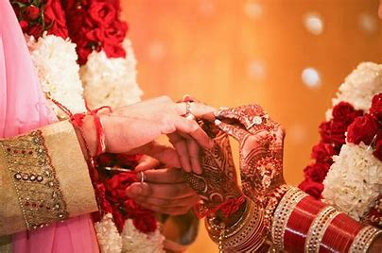
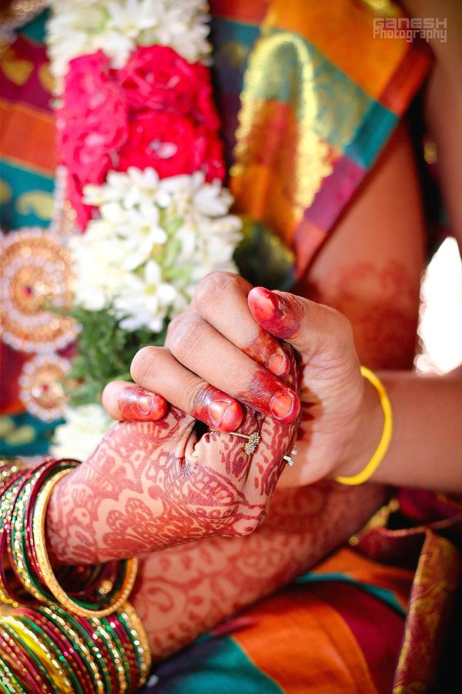
19G18
Tamil, Pillai Sozhiya Vellalar
DOB: 16/11/1991, Height: 5feet 2’’
Qualifications: BA Hons in Journalism
Currently working as a HR in Asda
Hobbies: Watching TV, movies, going out with friends, likes gym and enjoys food
Looking for a groom with a good family background, any professional jobs, good looking aged 27 to 32 years.
20G18
Tegulu, Hindu Brahmin
DOB: 1/12/1994, Height: 5feet 3’’
Qualifications: BDS (Dentist)
Currently working as a dentist
Hobbies: Indian Classical dance
21G18
Hindu Punjabi, Khatri
DOB: 25/5/1978, Height: 5feet5’’
Qualifications: B Pharmacy
Currently self employed as a Locum pharmacist
Hobbies: Gym, reading, travelling
Looking for well educated boy

Slide 32
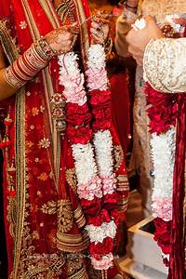
22G18
Hindu Punjabi, British, Divorced
DOB: 01/11/1972
Qualifications: BA in English Hons, Currently perusing Teaching Assistant course
Currently working as a teaching assistant in Primary school as volunteer
Hobbies: Cooking, watching movies, music, painting, acting, travelling, dance
Looking for a professional, good and understanding natured human being, financially secure, well educated
23G18
Hindu Brahmin-Iyer, Based in India
DOB: 17/12/1990
Qualifications: MBBS, MD(Final Year) – Clinical Microbiologist
Hobbies: Reading, TV Series, Travelling, socialising
Looking for a post-graduate doctor, caste no bar, caring, understanding, patriotic and liberal
24G18
Hindu Tamil, British Citizen
DOB: 22/04/1995, Height: 5feet 4’’
Qualifications: B Sc. Hons – Learning Disability
Currently working as a Mental health nurse
Hobbies: Movies, TV series, cooking, badminton
Looking for someone with similar personality

Slide 33
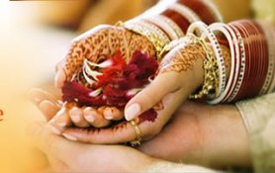
25G18
Hindu Telugu, British Citizen
DOB: 24/10/1996
Qualifications: B Sc. – Maths & Economics
Currently working as a Graduate Consultant at Ernst & Young
Hobbies: Socializing, singing, cooking, travelling, badminton
Looking for a suitable aspirant
26G18
Hindu Telugu, British Born/Citizen
DOB: 15/11/1993
Qualifications: Science graduate now in final yr MBChB in UK
Hobbies: Sports, Gym, Reading
Looking for a UK citizen doctor matches. Telugu origin but no bars language or caste wise.
27G18
No Longer Available
(Suitable Match found through Balaji Temple Matrimonial Service)

